Slide 1


Smart Invest
Buy a property below market value in Paris
Marine - Lorédane - Martin - Amaury
Notes:
Amaury

Slide 2

The problem we are trying to solve
Notes:
Amaury (1 min)

Slide 3
Why we are doing this project
🎯 Our approach
We use machine learning to estimate the fair market value of properties in Paris based on DVF transaction data (2020–2024), and compare it to current prices to flag potential investment opportunities.
🤔 The problem
Real estate investors in Paris face a major challenge:
they lack automated and reliable tools to identify properties that are undervalued relative to market trends.
Notes:
Amaury

Slide 4
Project steps
Find the appropriate DB
DB concatenation, cleaning & EDA
Run basic models (linear regression & RF)
Enrich the DB
Final models run on DB enriched (logs on mlflow)
Streamlit dashboard
Test our model on live real estate listings
Notes:
Amaury

Slide 5
The Database
Notes:
Loredane (2min)

Slide 6
The DVF French Database
DVF DATA OVERVIEW
137,917 transactions (2020-2024)
Official French government database
Complete transaction details
Precise geographic coverage
Notes:
Loredane

Slide 7
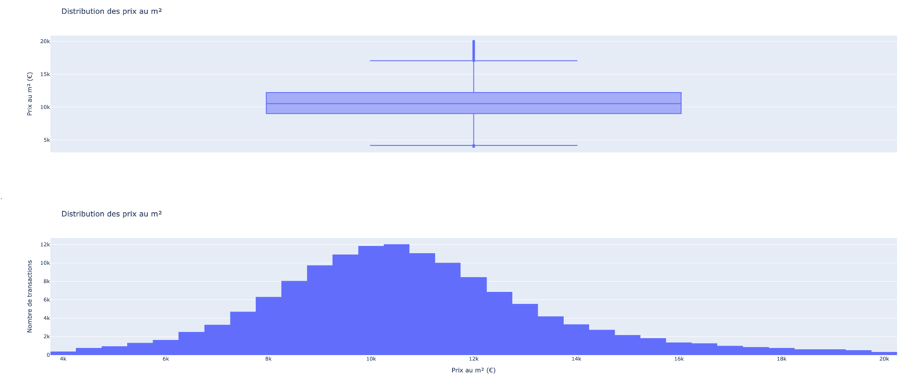
DB EDA (on target, “prix_m2”)
KEY STATISTICS • Median: 10,760 €/m² • Range: 8,949 - 14,256 €/m² • Normal distribution with outliers • Good spread for ML modeling
Notes:
Loredane

Slide 8

DB Clean
FILTERING DECISIONS
• Apartments only (no houses/commercial)
• Sales transactions only
• Removed abnormal prices & outliers
• Complete data points only
• Created price per m² target
The whole process is explained on the following Notebooks in our Github :
AAA_EDA.ipynb (Exploration on the whole DB to take decisions)
AAA_model_data_prep.ipynb (Preparation of the final csv used for our model)
Notes:
Loredane

Slide 9
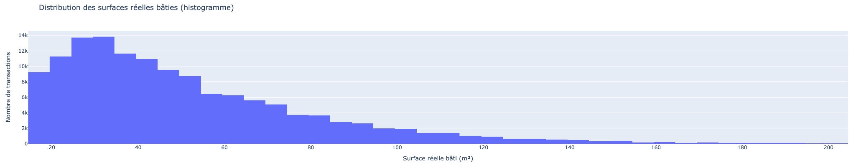
DB EDA (on features)
Notes:
Loredane

Slide 10
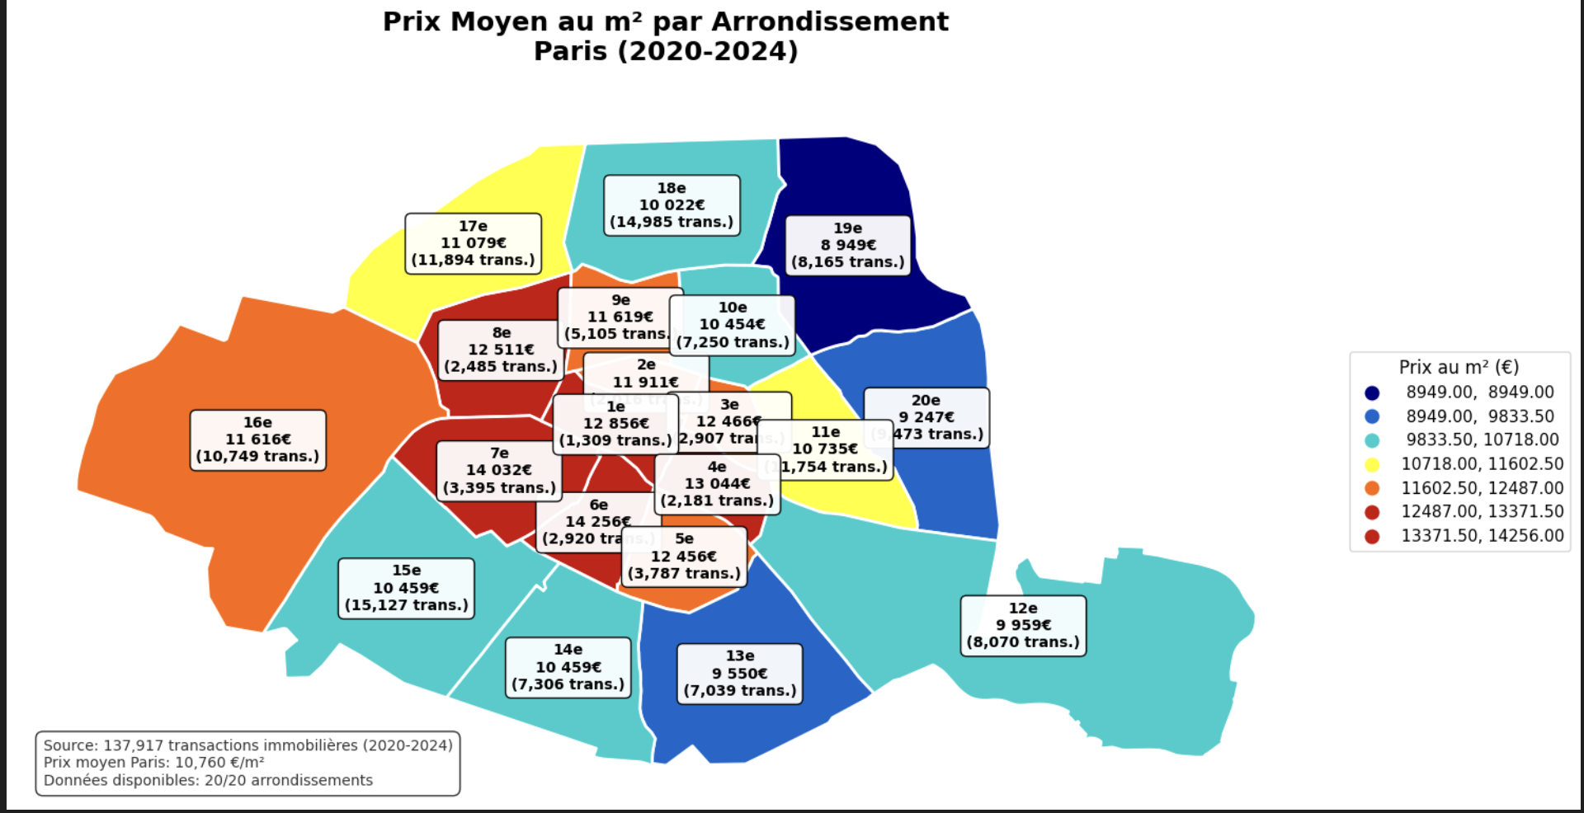
GEOGRAPHIC ANALYSIS
KEY INSIGHTS REVEALED
• 6th, 7th, 4th districts: Premium pricing (red)
• 19th, 20th, 13th districts: Most affordable (blue)
• Clear geographic gradient visible • Investment opportunities identified
Notes:
Loredane

Slide 11
ENHANCED FEATURES
DISTANCE-BASED FEATURES (KDTree Algorithm)
Transportation: Metro stations, TER/RER networks
Education: Schools, colleges, universities
Environment: Green spaces, building proximity
Urban amenities: Points of interest density
DATA ENRICHMENT SOURCES
Construction year: DPE (Energy Performance) database
Geospatial analysis: KDTree for efficient distance calculation
POI categorization: Dominant neighborhood characteristics
IMPACT ON PREDICTION
Location intelligence beyond coordinates
Neighborhood quality quantification
15% accuracy improvement over baseline
Notes:
Marine

Slide 12

The Models
ML Flow tracking here
Notes:
Amaury 4min

Slide 13
The approach
Test basic models (Linear regression & RF)
XG Boost Basic
XG Boost on RF with hyperparameters tuning
ML Flow tracking here
Notes:
Amaury

Slide 14
Results - metrics
Model Performance Comparison
Model | MAE (€/m²) | MAPE (%) | Status
Linear Regression | 1,730 | 16,2% | Baseline
Random Forest | 1,641 | 15.4% | Good performer
XGBoost Basic | 1,617 | 15.1% | Better
XGBoost Tuned | 1,596 | 14.9% | 🏆 Best model
→ XGBoost: ~1,600€/m² average error
ML Flow tracking here
Notes:
Amaury

Slide 15
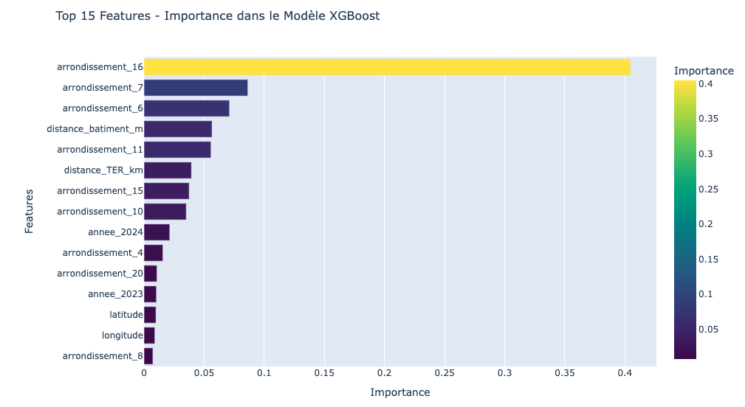
Results - Feature importance
🏆 MOST IMPORTANT FEATURES:
• District 16th (49.1% importance)
• Geographic location (longitude/latitude)
• Building proximity & metro distance
📉 SECONDARY FACTORS :
• Property characteristics (rooms, surface)
• Temporal factors (year)
Notes:
Amaury

Slide 16
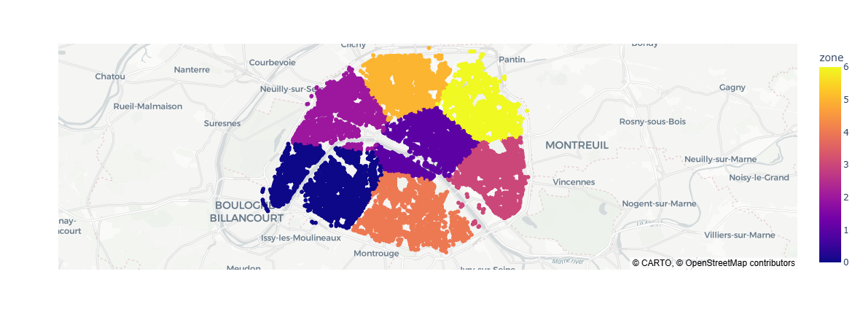
Test - Kmeans
Notes:
Martin

Slide 17
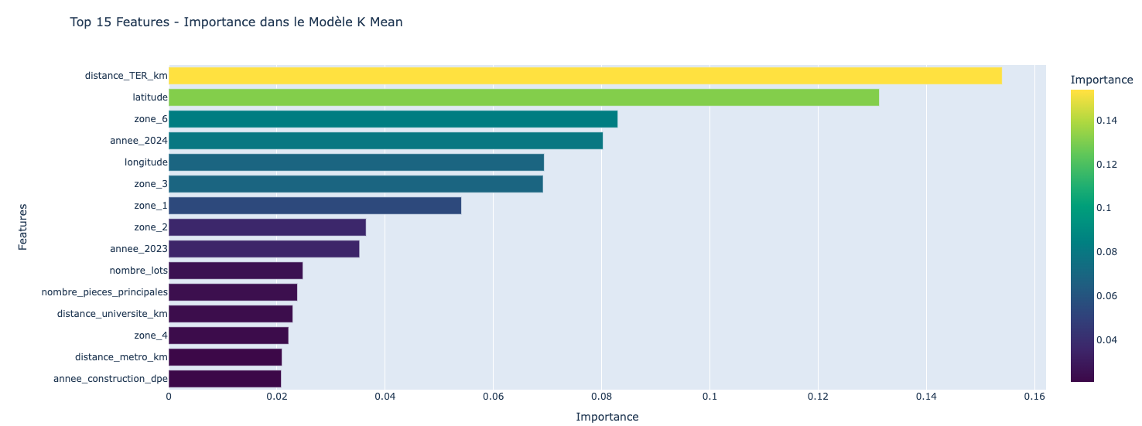
Results - Test with K Means
Notes:
Martin

Slide 18
Results - Interpretation (1 / 2)
Business Performance
PRACTICAL ACCURACY
• MAE: 1,596 €/m² average error
• MAPE: 14.9% relative error
• 75% predictions within ±20% of reality
BUSINESS APPLICATION
• Reliable for investment screening
• Competitive with market standards
• Requires human validation for final decisions
Notes:
Amaury

Slide 19
Results - Interpretation
Business Performance metrics with XGBoost
Business Performance Metrics:
Predictions within ±10%: 47.0%
Predictions within ±15%: 63.8%
Predictions within ±20%: 75.4%
Error distribution:
Median Absolute Error: 1,138€/m²
90th percentile error: 34.2%
📊 PRACTICAL APPLICATION:
- Model detects significant price deviations
- 75% of predictions within ±20% of reality (overall performance)
- For ONE specific transaction → manual investigation required
- Model = screening tool, not oracle
🎯 BUSINESS STRATEGY:
➡️ Use model to filter potential opportunities
➡️ Then manual validation (visit, expertise, negotiation)
Notes:
Amaury

Slide 20
Business usage of our model
Notes:
2 min

Slide 21
STREAMLIT
[ User ]
↓
┌───────────────┐
│ Streamlit App │ ← `app.py`
│ User Interface│
└───────────────┘
↓ calls
┌───────────────┐
│ FastAPI │ ← `main.py`
│ ML backend │
└───────────────┘
↓
Prediction (€/m²)
🖥️ Files overview
app.py → Streamlit interface (user inputs, charts, results)
main.py → FastAPI backend (loads model, returns predictions)
model.pkl → Final XGBoost model (MAE = 1596 €/m²)
📂 App path: `smartinvest_app/app.py`
🏃‍♀️ To run:
```bash
streamlit run smartinvest_app/app.py
📁 GitHub Repository
🔗 github.com/marinedde/smartinvest
Notes:
Marine

Slide 22
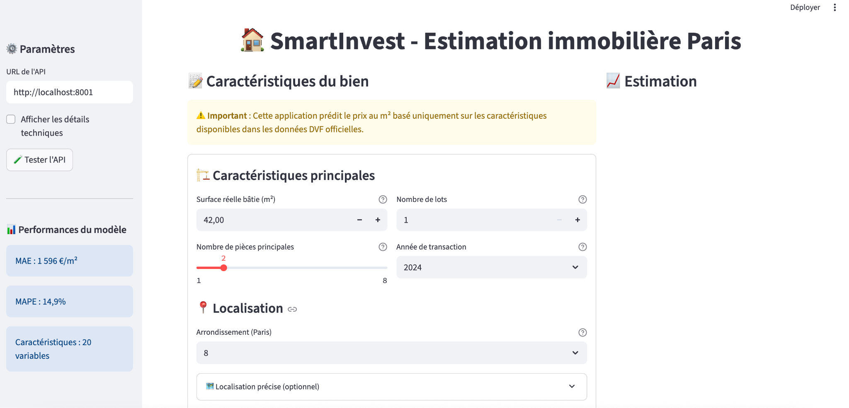
STREAMLIT
Notes:
Marine

Slide 23
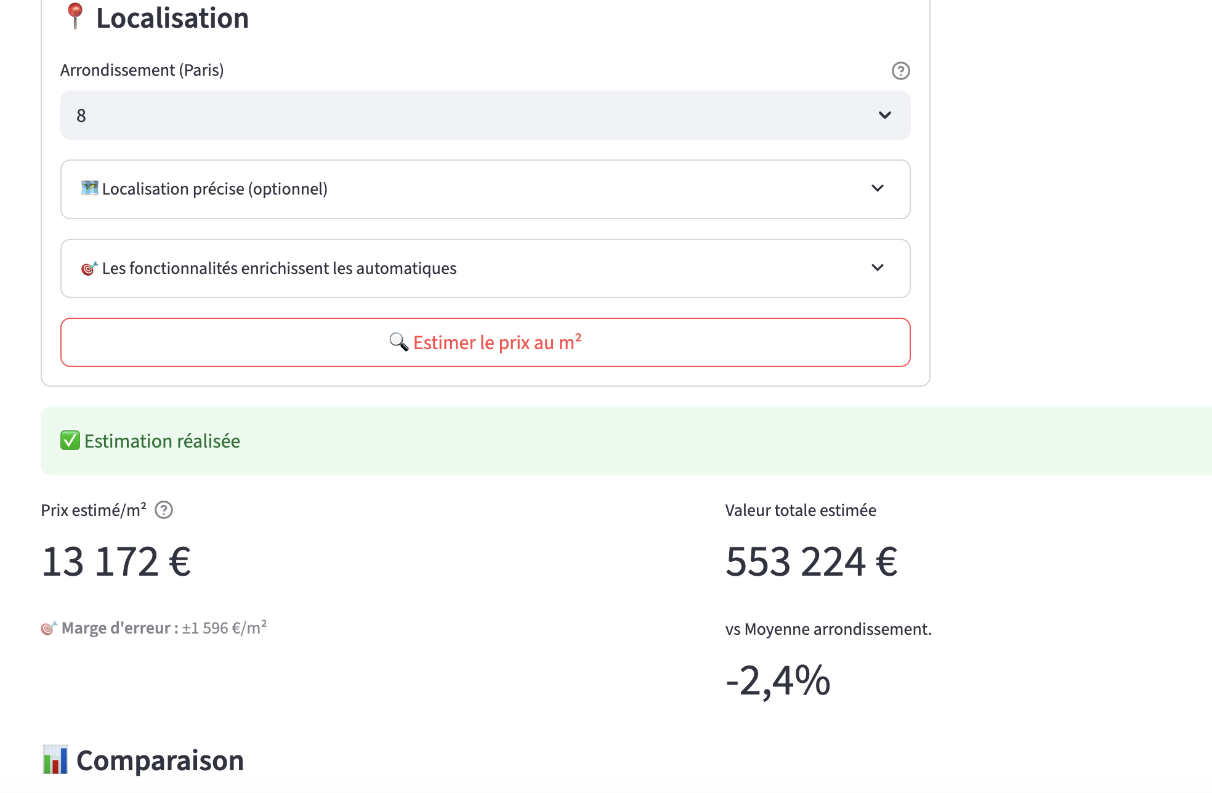
STREAMLIT
Notes:
Marine

Slide 24
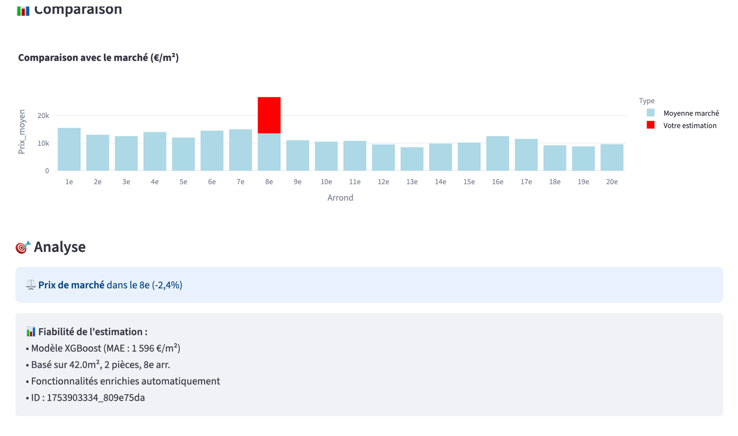
STREAMLIT
Notes:
Marine

Slide 25
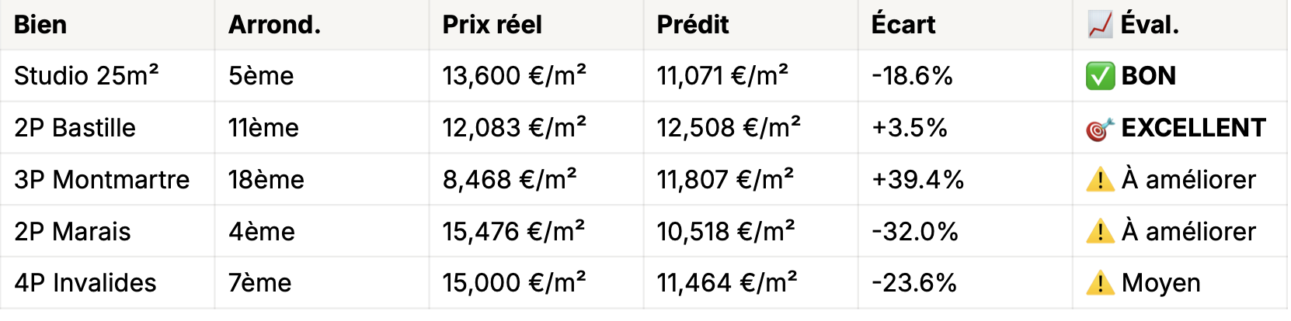
Real Market Validation
🎯 TESTED ON LIVE LISTINGS
Method: 5 real apartments from LeBonCoin, SeLoger, PAP, Orpi
📊 PERFORMANCE RESULTS
Average error: 2,958 €/m² (vs 1,596 training) • Success rate (±20%): 40% excellent predictions • Reliability: 100% realistic estimates • Best case: 3.5% error (11th district)
Notes:
Marine

Slide 26
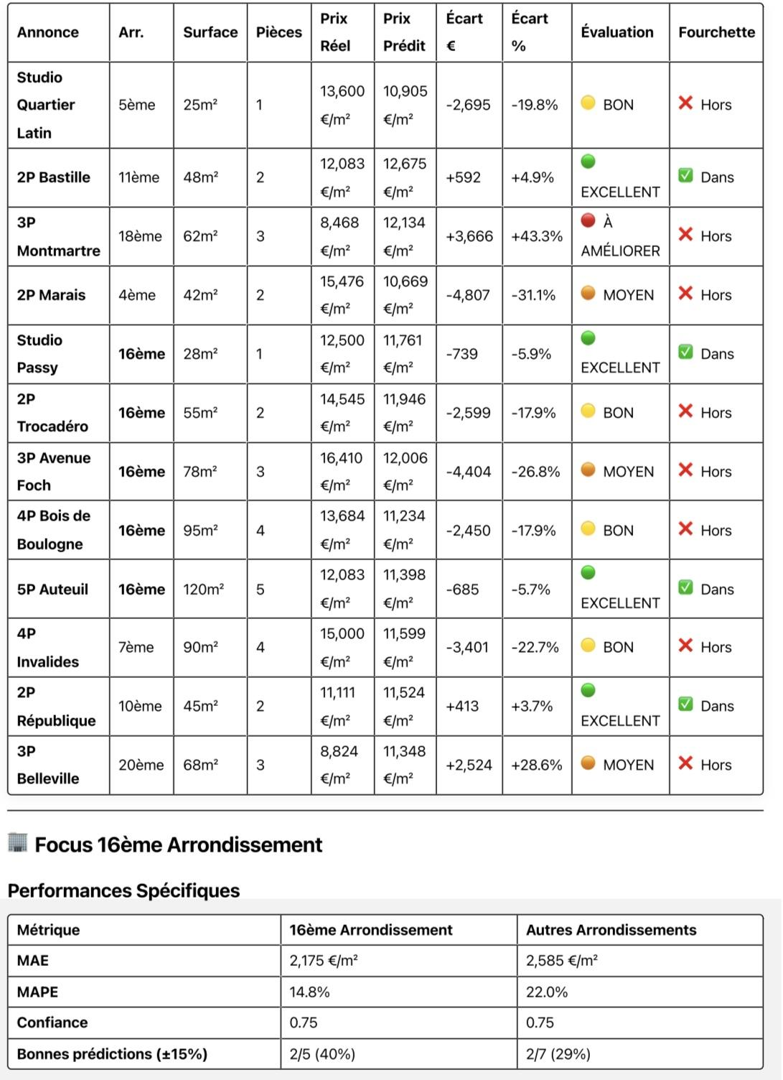
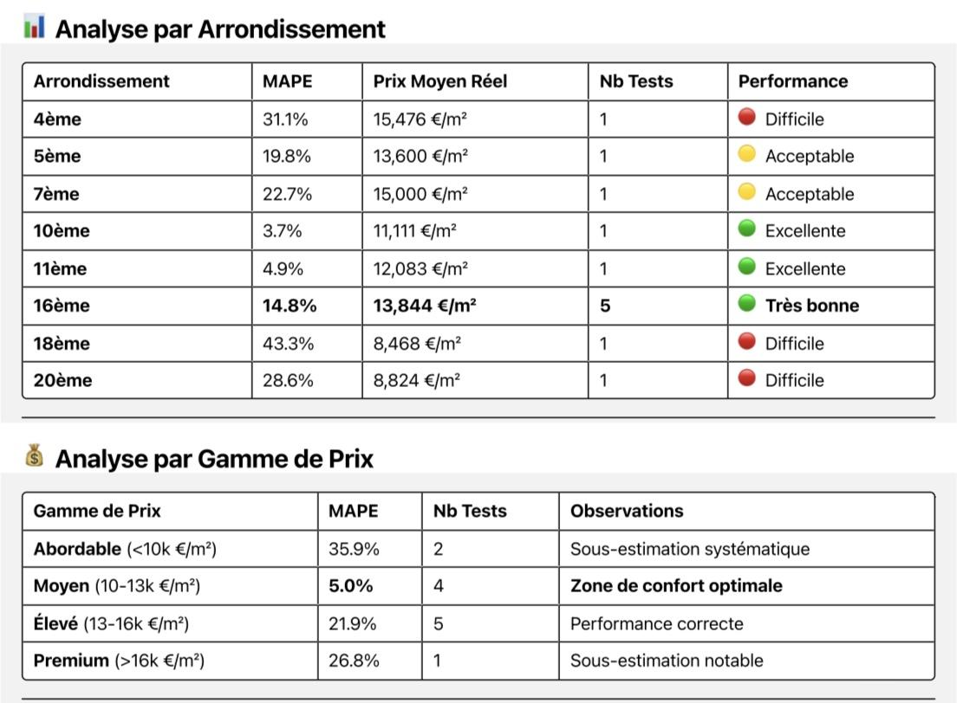
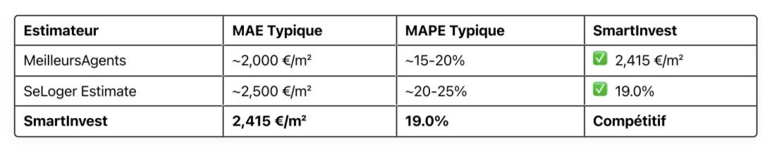
Real Market Validation
Notes:
Marine

Slide 27
Ideas to improve the model & Conclusions
Enrich the DB with more information on homes
We know that real estate prices depend on many other factors, that are not in our DB :
The condition of the home (requires construction or not)
Floor
Balcony / Terrace
View
Negotiation
We believe those factor strongly affect the price and would be crucial to improve our model. However, they are not part of the public data so we could contact notary offices, buy data from real estate players (such as meilleursagents etc.)
While capturing 34% of price variance in a complex market like Paris, our model serves as a powerful first-stage filter for investment opportunities, requiring human expertise for final validation but significantly improving deal sourcing efficiency.
Notes:
Martin 1 min

Slide 28

Thanks!

